Slide 1
Databases
IS212

Slide 2
Prof. Dr. Taysir Hassan Abdel Hamid
Information Systems Department,
Faculty of Computers & Information,
Assiut University
taysirhs2@gmail.com
Office hours: Thursday 12-2
April 27, 2021

Slide 3
Agenda
Book Used
Lecture attendance regulations
Grading scheme
Chapter 1: The Database Environment and Development Process

Slide 4
Book Used
Jeffery A. Hoffer, Mary B. Prescott, and Heikki Topi. Modern Database Management. Pearson International Edition, 9th Edition, 2009.
Ramez Elmasri and Shamkant B. Navathe. Fundamentals of Database Systems. Peasron Education, Inc., USA. 7th edition, (2016).

Slide 5
Grading Scheme: Total 100
Final Exam (50 points):
Midterm Exam: 15 points
Quizzes: 5
Interaction within class: 5 points
Lab exam: (10 points)
Project: 10 points
Attendance: 5 points

Slide 6
Important Definitions in this chapter
What is a Database?
Data
Data versus Information
Metadata
Traditional file processing
Data model
Entity
Database management system
Enterprise data model
Relational database

Slide 7
Enterprise Resource Planning (ERP) system,
Database application
Data warehouse
Data independence
Repository
User view
Systems Development Life Cycle (SDLC)
Prototyping
Agile software development
Computer-Aided Software Engineering (CASE)
Conceptual schema, logical schema, and physical schema.

Slide 8
A Database
Is a set of collection of related data (known facts).
Often abbreviated DB. A collection of information organized in such a way that a computer program can quickly select desired pieces of data. You can think of a database as an electronic filing system.
A database may be of any size and complexity. For example, a salesperson may maintain a small database of customer contacts—consisting of a few megabytes of data—on her laptop computer.
A large corporation may build a large database consisting of several terabytes of data (a terabyte is a trillion bytes) on a large mainframe computer that is used for decision support applications

Slide 9
Data Versus Information
The terms data and information are closely related, and in fact are often used interchangeably.
However, it is useful to distinguish between data and information.
We define information as data that have been processed in such a way that the knowledge of the
person who uses the data is increased.

Slide 10
Data
Baker, Kenneth D. 324917628
Doyle, Joan E. 476193248
Finkle, Clive R. 548429344
Lewis, John C. 551742186
McFerran, Debra R. 409723145

Slide 11
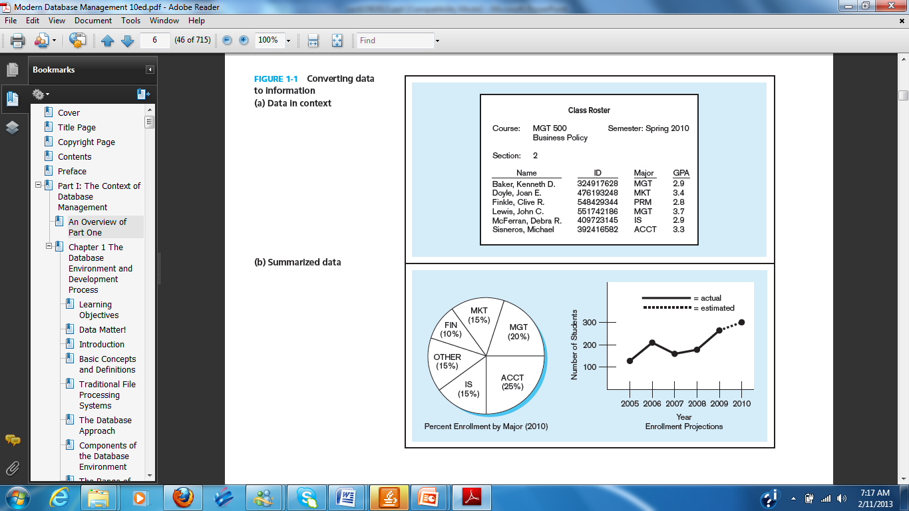
Converting Data into Information

Slide 12
Metadata
Data become useful only when placed in some context.
The primary mechanism for providing context for data is metadata.
Metadata are data that describe the properties or characteristics of end-user data and the context of that data.
Some of the properties that are typically described include data names, definitions, length (or size), and allowable values. Metadata describing data context include the source of the data, where the data are stored, ownership (or stewardship),
and usage.
Although it may seem circular, many people think of metadata as “data about data.”

Slide 13
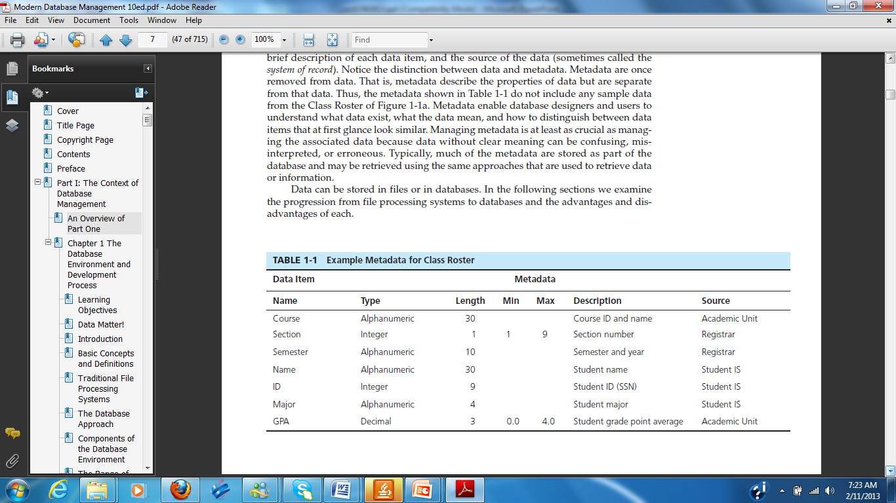

Slide 14
Traditional File Processing
When computer-based data processing was first available, there were no databases.
To be useful for business applications, computers had to store, manipulate, and retrieve large files of data.
Computer file processing systems were developed for this purpose.
Although these systems have evolved over time, their basic structure and purpose have changed little over several decades.

Slide 15
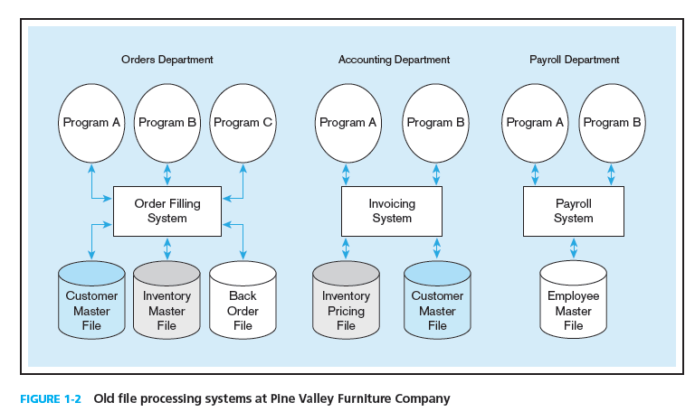
Pine Valley Furniture Company

Slide 16
Disadvantages of File Processing Systems
Program dependence
Duplication of data
Limited data sharing
Excessive program maintenance
Lengthy development time

Slide 17
Properties of Database
A database is a logically coherent collection of data.
A database is designed, built, and populated with data for a specific purpose.
A database represents some aspect of the real world, sometimes called the miniworld

Slide 18
Example 1:
It records a lot of facts about some subject, such as
      customers, orders and product stock
      students, courses and results
      blog or discussion forum entries

Slide 19
Example:
Imagine you create a list of people with whom you have some type of relationship. The list can be started with names as follows: Bill, James, Hermine, and Khan. This type of list is considered one-dimensional because all of its items fit in one category. In order to create a more significant list, you may want to include these people’s email addresses and probably other related information. If you include these additional pieces of information in the same category, the list may become confusing. To arrange the list, you would create categories. Here is an example:

Slide 20
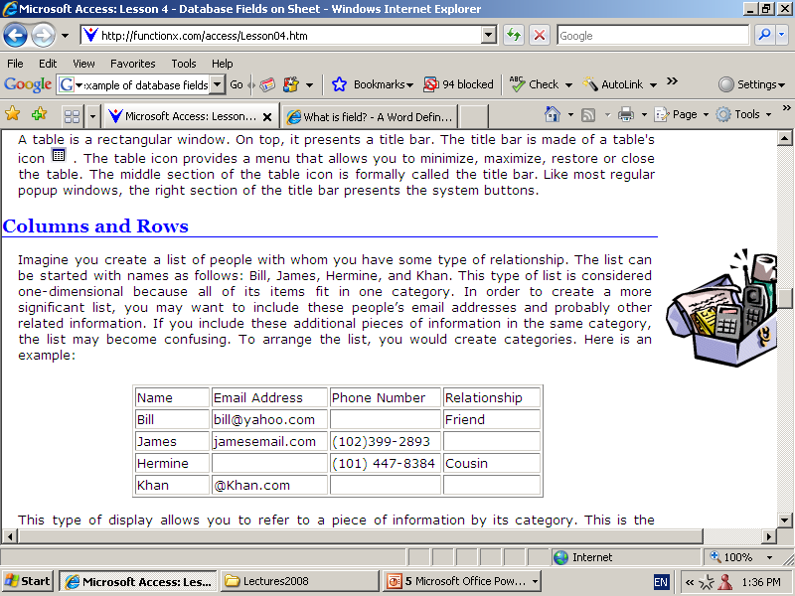
Columns & Rows

Slide 21
A Table
A table is a two-dimensional list of items so that the items are arranged by categories.
A complete or incomplete series of items that represent each category is called a record. Therefore, a table can be represented as follows:

Slide 22
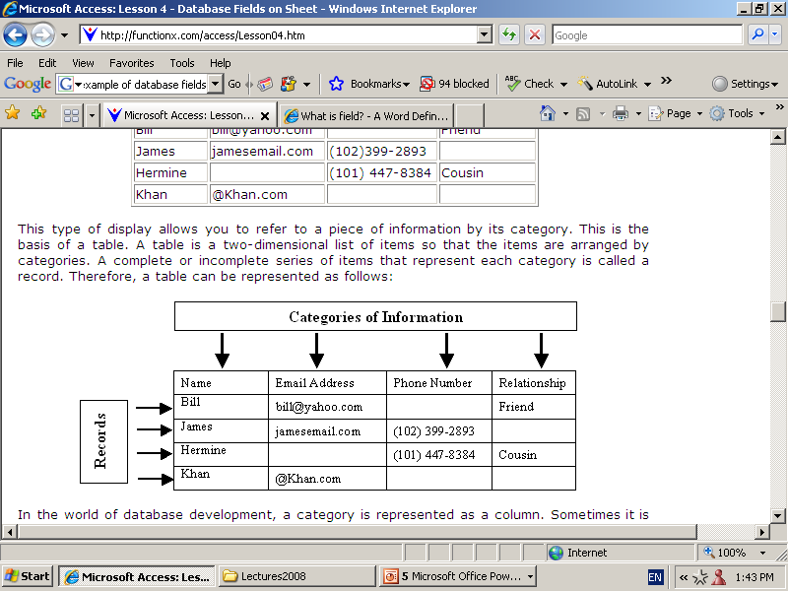

Slide 23
The Database Approach
Data Models
Entities
Relationships

Slide 24
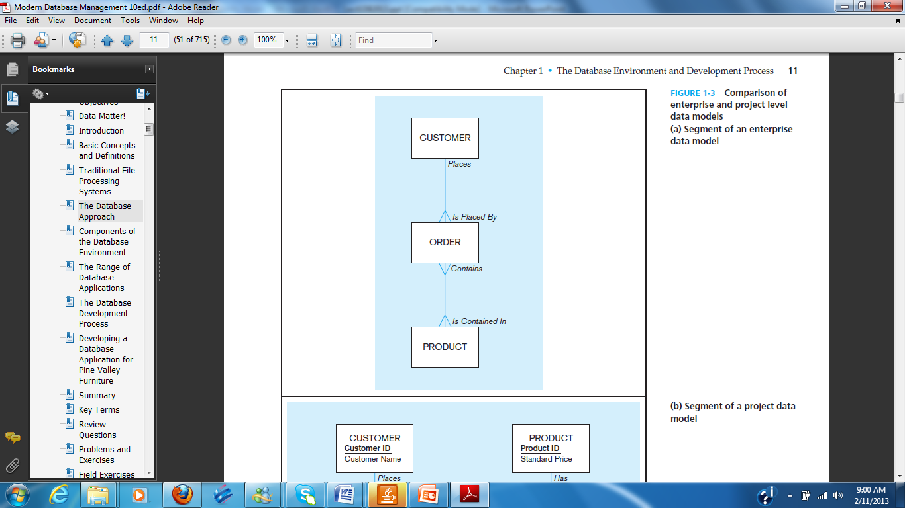

Slide 25
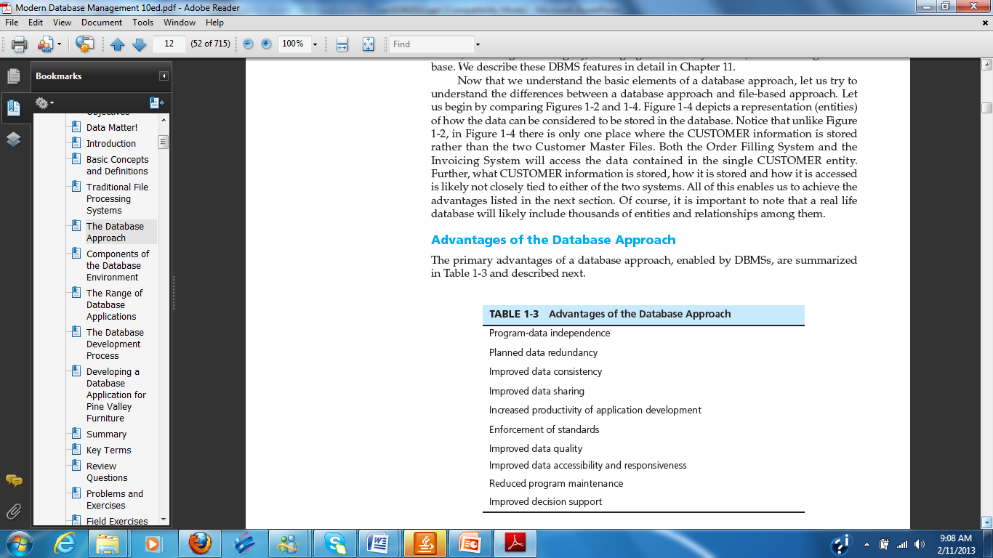

Slide 26
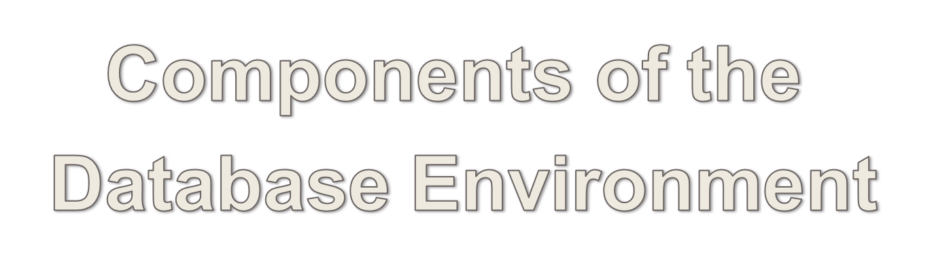

Slide 27
Components of the
Database Environment
CASE Tools – computer-aided software engineering
Repository – centralized storehouse of metadata
Database Management System (DBMS) – software for managing the database
Database – storehouse of the data
Application Programs – software using the data
User Interface – text and graphical displays to users
Data Administrators – personnel responsible for maintaining the database
System Developers – personnel responsible for designing databases and software
End Users – people who use the applications and databases

Slide 28
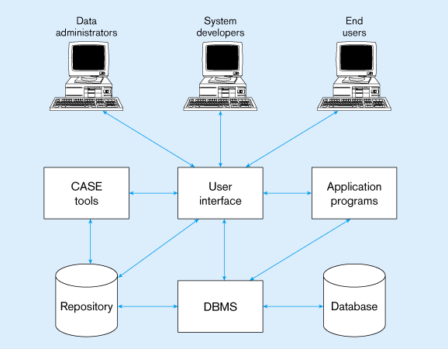
Figure 1-11 Components of the database environment

Slide 29
What is a Database Management System (DBMS? )
A DBMS has several advantages over “raw” computer files
    database is “self-describing”
    data is “abstract,” independent of the programs that use it
    different users can have different “views” of the data
    supports simultaneous users, “transaction” processing

Slide 30
A Database Management System (DBMS)
Is a general-purpose software system that facilitates the process of:
Defining
Constructing
Manipulating
Sharing
Representing
Protecting

Slide 31
To use a database effectively one needs ways to:
Add data
Delete data
Change data
Look up or search for particular data
Organize the data
Organize interactions with the data
Maintain conventions for understanding the meaning of the data.

Slide 32
A Database Management System (DBMS) (in details)
a. Defining – Specifying data types, structures, and constraints for the data to be stored in the database.
b. Constructing – Storing the data itself on some data storage medium, controlled by the DBMS.
c. Manipulating – Querying the database.
d. Sharing – Accessing the database my multiple users.
e. Representing the data – Providing the users with a conceptual representation of data that does not include how the data is stored.
f. Securing the data – Protecting a database includes both system protection against hardware/software problems and security issues.

Slide 33
Advantages of Using the DBMS Approach
Controlling redundancy – in file processing, every user group maintains its own files for handling its data-processing applications.
Restricting unauthorized access
Providing persistent storage for program objects (object-oriented database systems).
Providing storage structures for efficient query processing
Providing backup and recovery

Slide 34
Advantages of Using the DBMS Approach (Cont.)
Providing multiple user interfaces
Representing complex relationships among data
Enforcing integrity constrains
Permitting inference and action using rules (deductive database systems).
Reduced application development time
Flexibility
Availability of up-to-date information
Enforcing standards among users in a large organization.
Reducing the amount of wasteful overlap between activities of data processing

Slide 35
DBMS Examples
Oracle
Sybase
Microsoft SQL Server
DB2 (IBM)
MySQL (Open source)

Slide 36
Actors on the Scene
Database administrators
Database designers
System analysts – determine requirements of end users
End users:
  Casual end users – occasionally access the database
  Naïve or parametric end users – querying and updating databases
  Sophisticated end users – scientists, engineers.
  Stand-alone users – maintain personal databases and use ready-made program packages that provide easy-to-use menu-based or graphic-based interfaces.

Slide 37
Workers Behind the Scene
DBMS system designers and implementers
Tool developers
Operators and maintenance personal

Slide 38
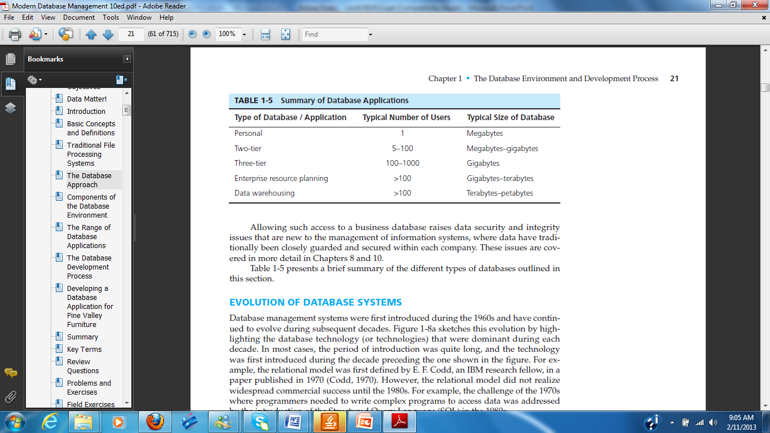

Slide 39
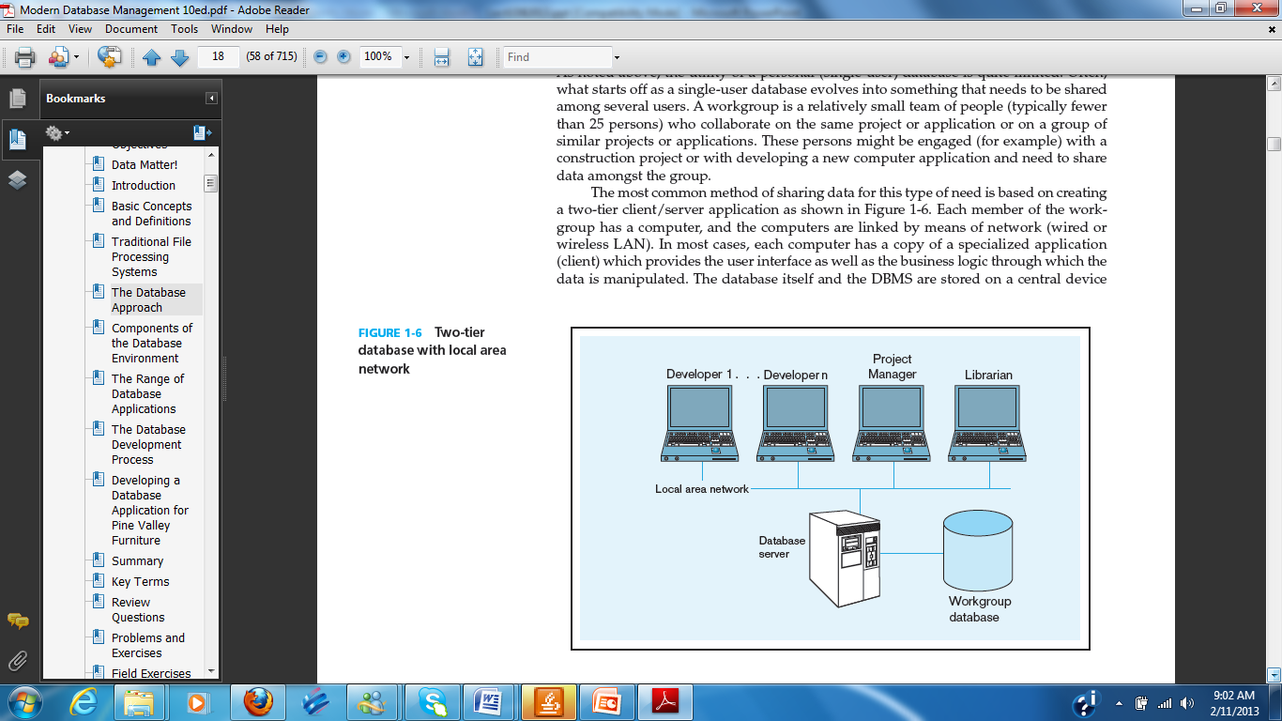
Client-server Architecture

Slide 40
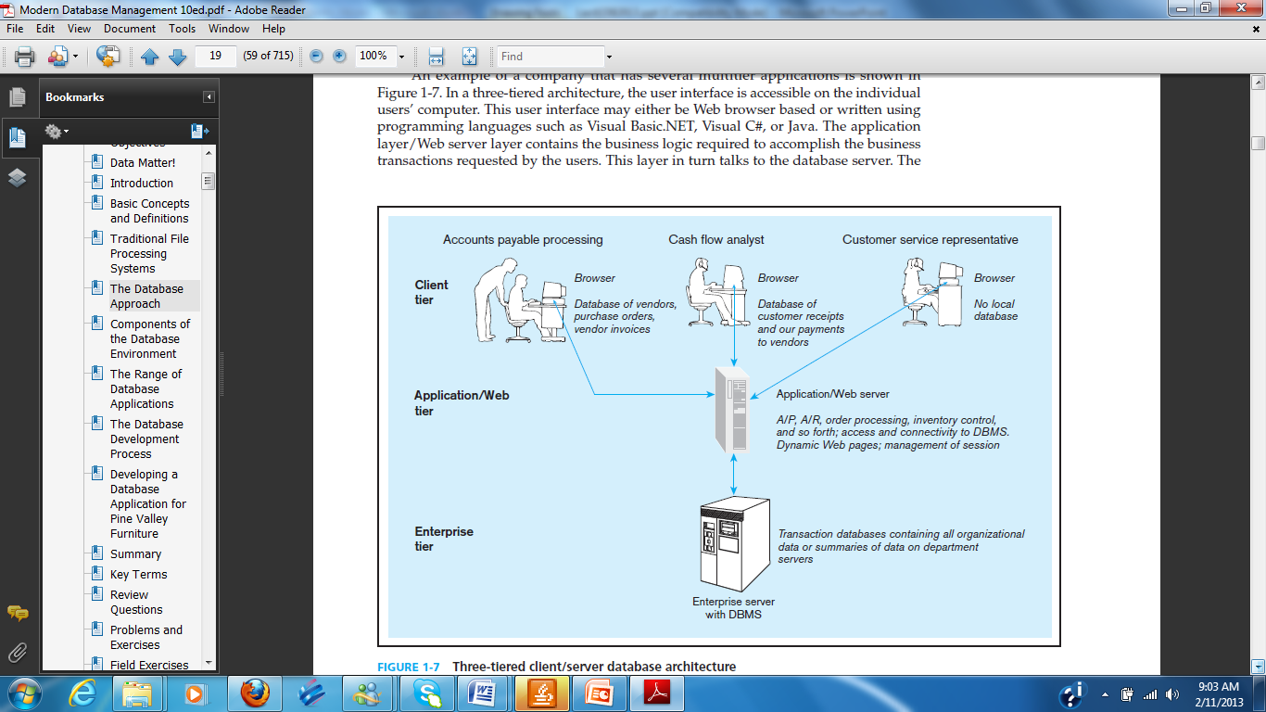
Three-tier Architecture

Slide 41
System Development Life Cycle

Slide 42
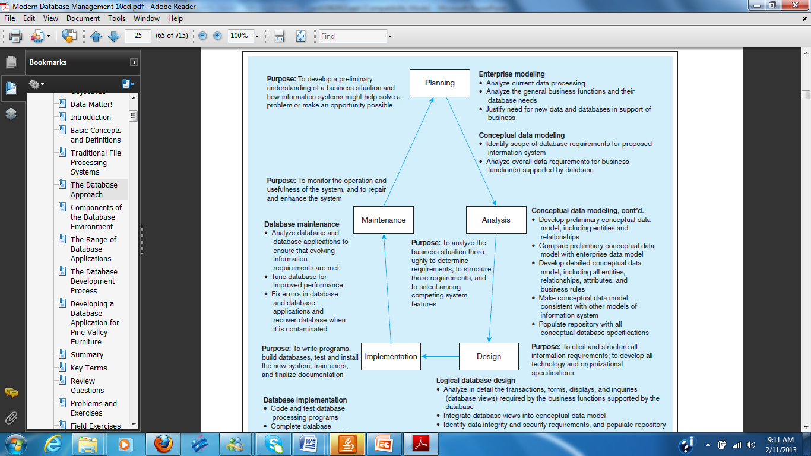

Slide 43
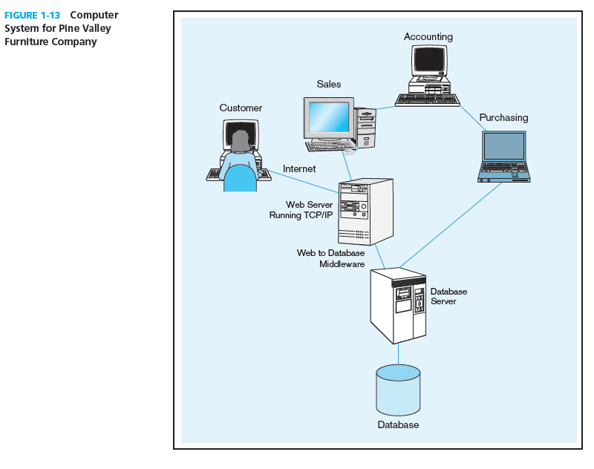

Slide 44
Enterprise Database Applications
Enterprise Resource Planning (ERP)
  Integrate all enterprise functions (manufacturing, finance, sales, marketing, inventory, accounting, human resources)
Data Warehouse
  Integrated decision support system derived from various operational databases

Slide 45
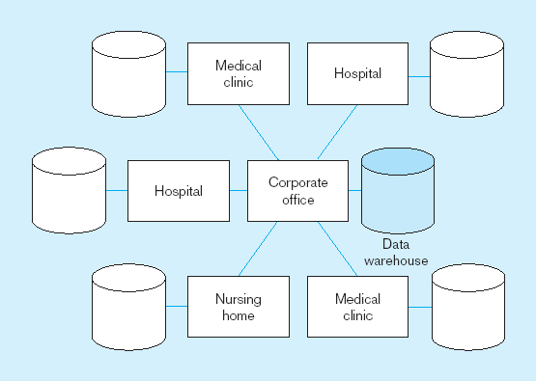
Figure 1-8 An enterprise data warehouse

Slide 46
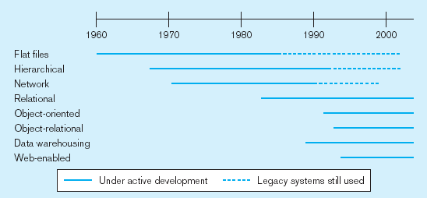
Evolution of DB Systems

Slide 47
Review Questions
Define the following terms: Database, DBMS, DBA
Define metadata and give an example

Slide 48
THANK YOU

